Slide 1
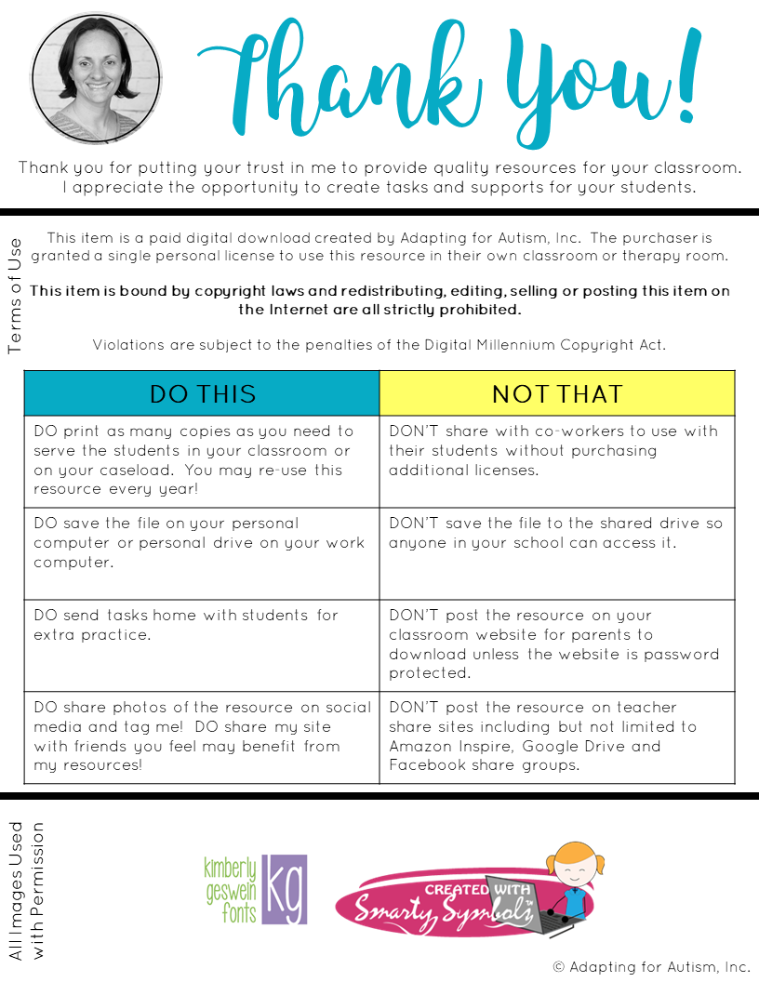

Slide 2
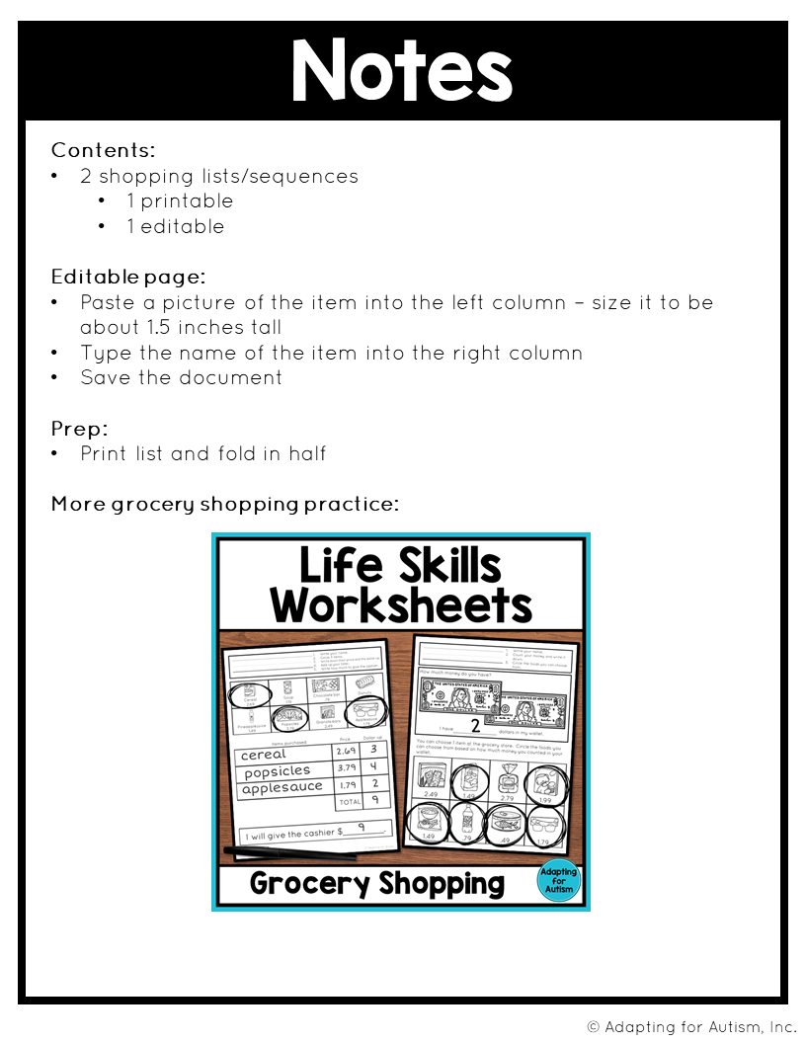
Grocery Shopping Life Skills Worksheets

Slide 3
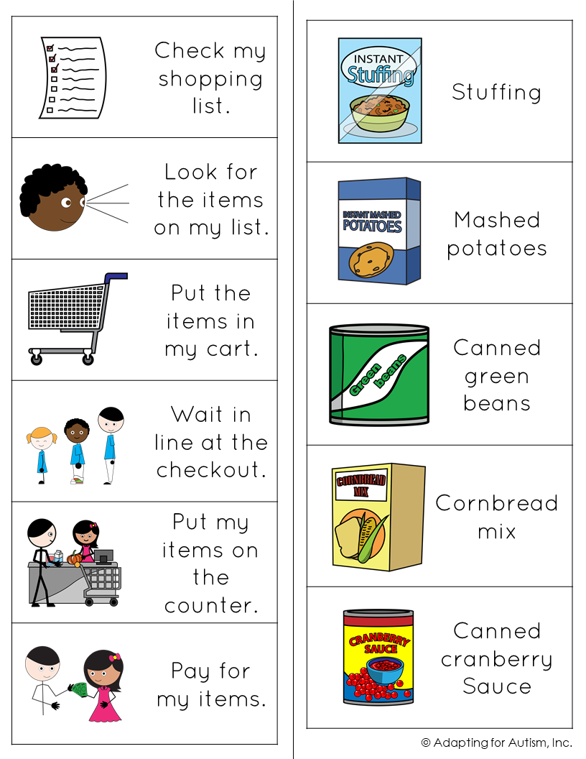

Slide 4
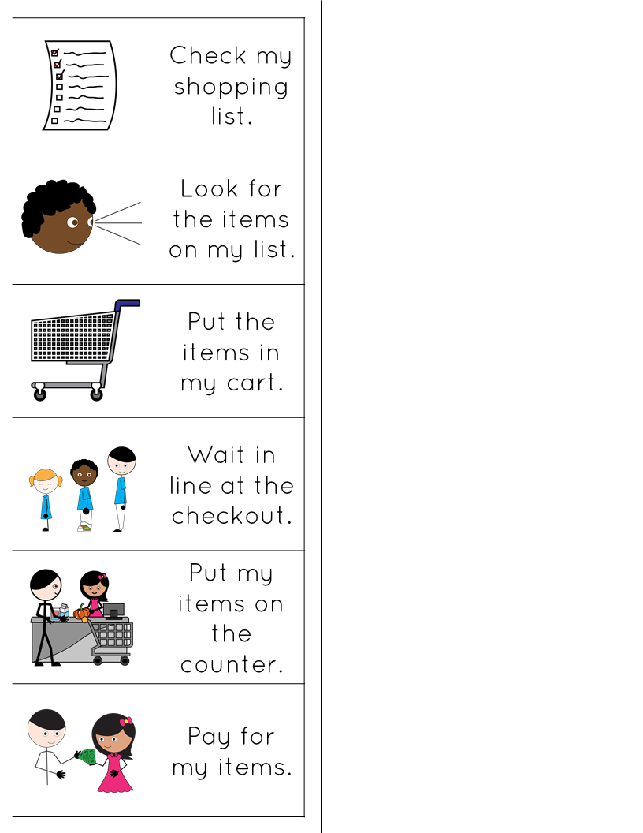
Paste a picture in this column
Type in this column
 | text
 | text
 | text
 | text
 | text
© Adapting for Autism, Inc.

